Slide 1
Weekly Update 10
Malicious code injection

Slide 2
Where We were
We were mainly working on “Using system calls to detect malicious code injection”. We were using a tree which may contain the path to produce that kind of attack. Using the tree, we were able to identify the code injections(html injection, script injection and sql injection) that were using root privilege. But we could not identify the RCE(Remote code execution) which does not necessarily require any credential or root privilege.

Slide 3
Limitation of our previous approach
We were using only the name of the system calls to identify any kind of malicious code injection.
As a result, if an attacker upload or inject a malicious script only using the vulnerable website we could not distinguish between a benign upload and a malicious upload.
Our limitation was that we were not using any other parameters of the system calls aside their name.

Slide 4
Current Approach
In our latest update, we will show a new approach to detect malicious code injection even if it done by RCE(experimental)
In this case, we will be using the frequency of some important system calls.
This method is demonstrated in this paper:
A Study on Container Vulnerability Exploit Detection; Author: Olufogorehan Tunde-Onadele, Jingzhu He, Ting Dai, Xiaohui Gu
Department of Computer Science, North Carolina State University

Slide 5
Our doings
We used seed lab XSS attacks to identify the code injection using RCE.
Our next few slides will demonstrate our findings.

Slide 6
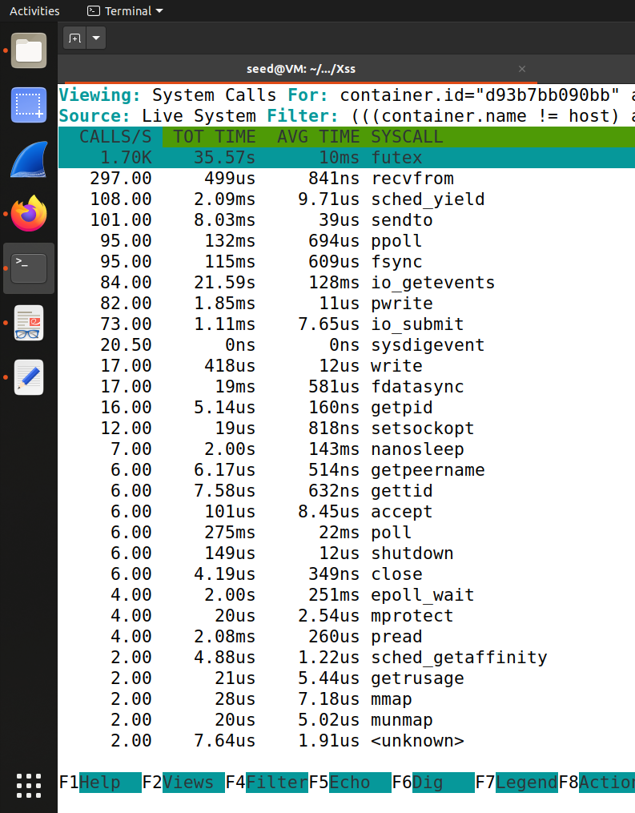
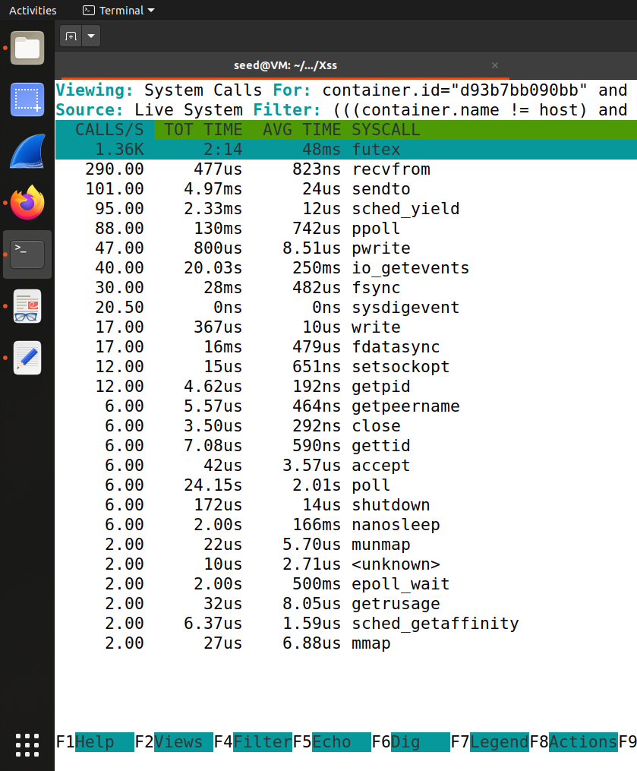
Benign Edit in Attacker profile
Anomalous Edit in Attacker profile

Slide 7
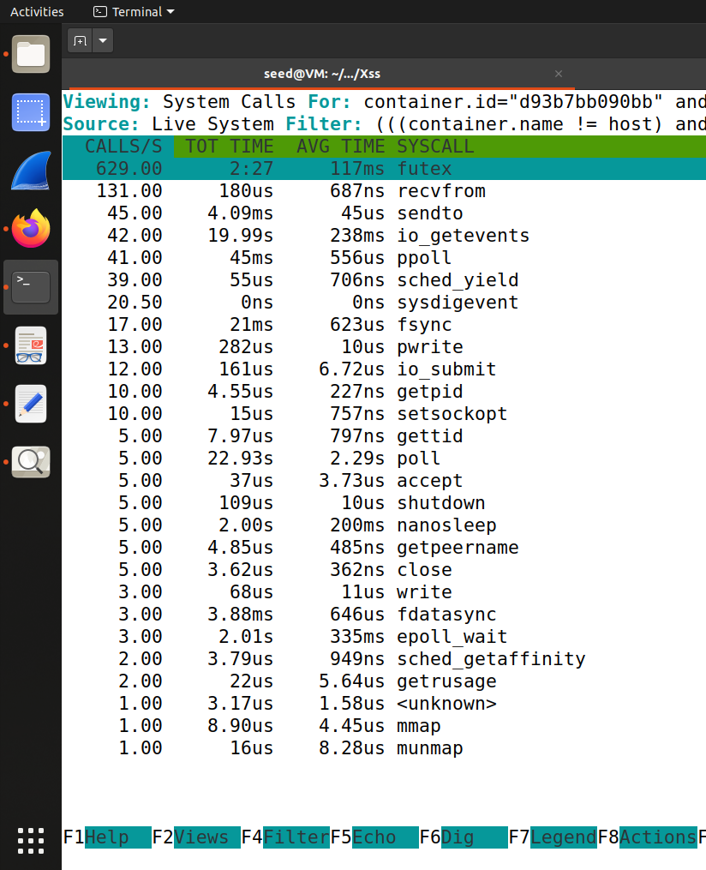
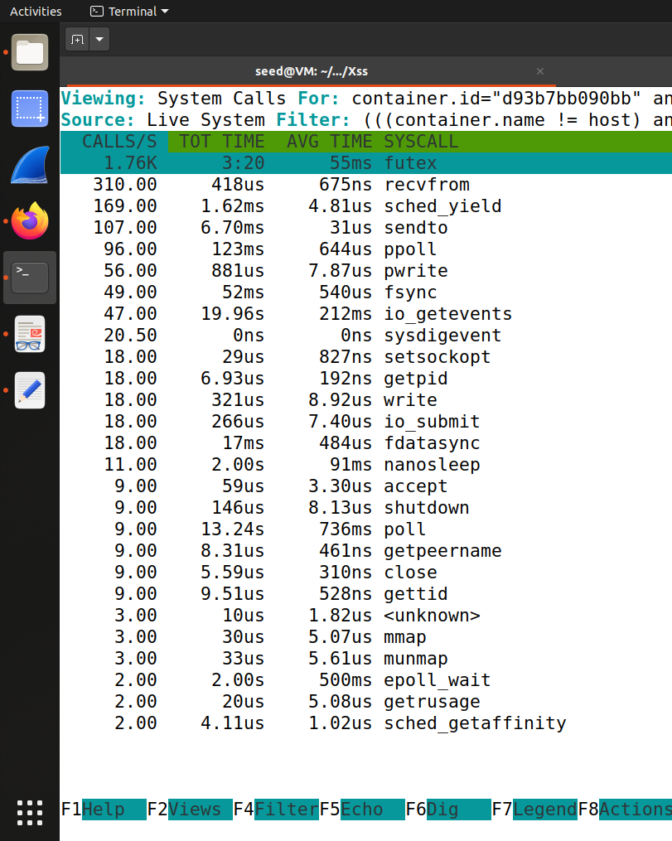
Benign Profile Visit
Anomalous Profile Visit

Slide 8
Our Findings
We can observe that when a normal user visit attacker profile, given that the profile is set up for an attack on any visitor, the frequency of system calls differ a lot from a normal profile visitation. We mainly focus on 4 system calls as mentioned in the paper - Futex, Read, Write and Epoll-wait

